Slide 1
36104 Data Visualisation and Narratives Assignment 1
Dan V Hansen – Student Number: 24718999

Slide 2
Analysis AFL Games Margins
Introduction:
The analysis was performed on all minor round games from 2000 to 2019.
Every minor round games has an official home team and an away team.
Finals were not utilised as these games are officially neutral games.
The margin was calculated as the difference between the score of the home team and that of the away team.
The data was sourced from afltables.com.

Slide 3
Analysis AFL Games Margins
There was a total of 3,707 games, which ranged from a 157 point defeat to the home team, and a maximum victory of 186 points.
The average result was a 7.2 point win to the home team with a standard deviation of 44.1 points.
A bar graph was utilized to display the normal distribution of margins.
Based on the probability density function, the inferred likelihood of a home team victory is 56.5%.

Slide 8
Analysis AFL Games Margins
There are data subsets within main data sample. One example is where a team hosts a team from another state.
There were 2,141 games where the home team had the additional advantage of hosting a team from interstate.
The average result for these games was a 10.8 point win to the home state team with a standard deviation of 44.6 points.
The normal distribution of this subset was displayed on the same bar graph.
This home state advantage increase the probability of a home team victory to 59.6%.

Slide 14
Analysis AFL Games Margins
However, sometimes the team from interstate is a stronger team than the home team.
A method of indexing the two teams was devised in order to measure the two teams' strengths.
The results of a teams last ten games was aggregated and the teams total score was expressed as a percentage of total score.
This will result in the index range being bounded between 0% and 100%, with the majority of teams situated in proximity to 50%.
By utilising these indices, previous games involving teams of comparable strengths can be used to calculate probabilities.

Slide 15
Analysis AFL Games Margins
For example, on 1 April 2023 the Greater Western Sydney Giants host Victorian based Carlton at Homebush.
GWS has a last ten game percentage of 43.1%, whilst Carlton has a rating of 50.1%.
There were 72 games where a team with a “rating” of 43.1% (± 2%) hosted an interstate team of 50.1% (± 2%).
This subset produced an average outcome of an 11.3 point victory for the visiting team, with a standard deviation of 39.6 points.
This produces a probability of a 61.3% win to the away team Carlton.

Slide 23
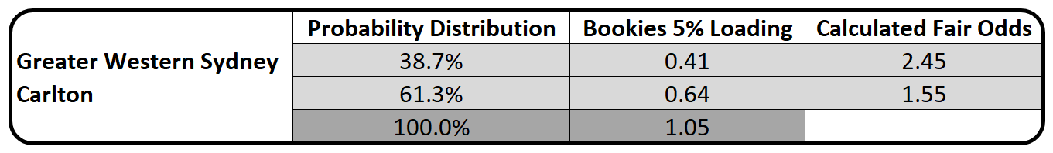
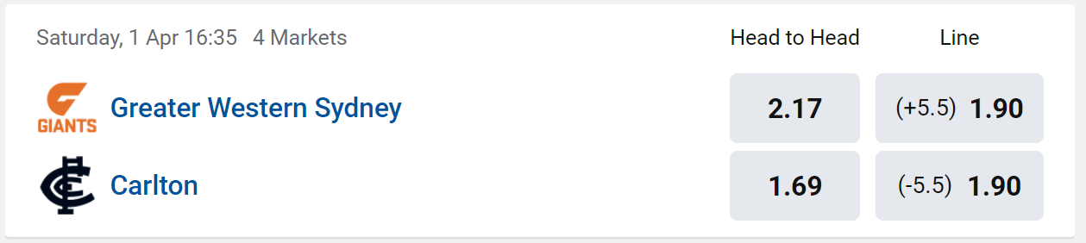
Analysis AFL Games Margins
Based on this analysis the odds offered for Carlton should be $1.55.
This corresponds with the odds offered by the betting agencies of $1.69.
Conclusion:
In this case Probability Distribution Theory aligns well with the betting market.

Slide 24
Tools Used:
VS Code and python
DBeaver and PostgreSQL
MS Excel
MS PowerPoint
Zoom
MS Video Editor
Dan V Hansen – Student Number: 24718999

